Slide 1

The Israeli Economy Towards 2014
Polish Israeli Business Forum – November 2013
Dan Catarivas
Manufacturers Association of Israel (MAI)

Slide 2
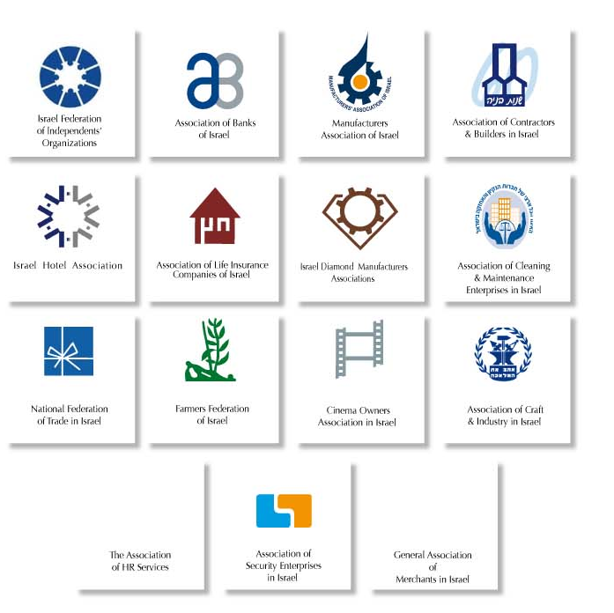
Federation of Israeli Economic Organizations (FIEO)
Manufacturers Association of Israel
Federation of Israeli Chambers of Commerce
Association of Contractors & Builders in Israel
Farmers’ Federation of Israel
Association of Banks of Israel
Israel Diamond Manufacturers Association
Israel Hotel Association
General Association of Merchants in Israel
Association of Life Insurance Companies of Israel
Association of Craft and Industry in Israel
National Federation of Trade in Israel
Cinema Owners Association in Israel
Israel Federation of Independent's Organizations – LAHAV
Association of Security Enterprises in Israel
Israeli Cleaning and Maintenance Union

Slide 3

Manufacturers Association of Israel (MAI)
Established in 1921
An Independent private organization
Self-Financed
Israel’s largest and most influential economic organization
Largest employers’ organization, representing 90% of the industrial output
President of MAI is also the President of the Federation of Israeli Economic Organizations (FIEO)
“The Voice of the Industry”

Slide 4
President
Director General
Small & Medium Factories Division
Labor & HR Division
Finance and Administration Division
Economics Division
Communications Division
Foreign Trade & International Relations Division
Start-Up Unit
Association of Electronics, Information & Software Industries
Building Materials & Consumer Goods Association
Chemical, Pharmaceutical & Environmental Society
Metal, Electrical & Infrastructure Industries Association
Food Industries Association
Textile & Fashion Industries Association
Kibbutz Industries Association
Haifa Branch
Southern Branch
Jerusalem Branch

Slide 5
The Israeli Economy 2012 Facts & Figures
GDP ($ Billions) 240
Population (8/2012, Millions) 7.9
GDP per Capita ($) 30,357
Foreign Trade (% of GDP) 77%
Total Exports (% of GDP) 38%
Unemployment (9/12) 6.8%
Business Sector Share in GDP 72%
Industry Share of Business Sector 20%

Slide 6
The Israeli Economy
Main Characteristics
Export Oriented Growth
Technologically Advanced & Hi-Tech Oriented
High Skilled Human Capital
Entrepreneurial Culture
Incentives for R&D & Investment

Slide 7
A Growing Economy in an Era of Decline Growth in Selected Developed Economies 2011-2012
Source: OECD
Notes:
Y:\מסמכים בטיפול סטטיסטיקה\קבצי אקסל\מצגות גרפיות\גרפים - תוצר והשוואה בינל.xls

Slide 8
Rapid Growth of the Economy
Aagr: 4.2%
4.6%
2.4%
Notes:
קבצי אקסל>מצגות גרפיות>גרפים – תוצר והשוואה בילאומית

Slide 9
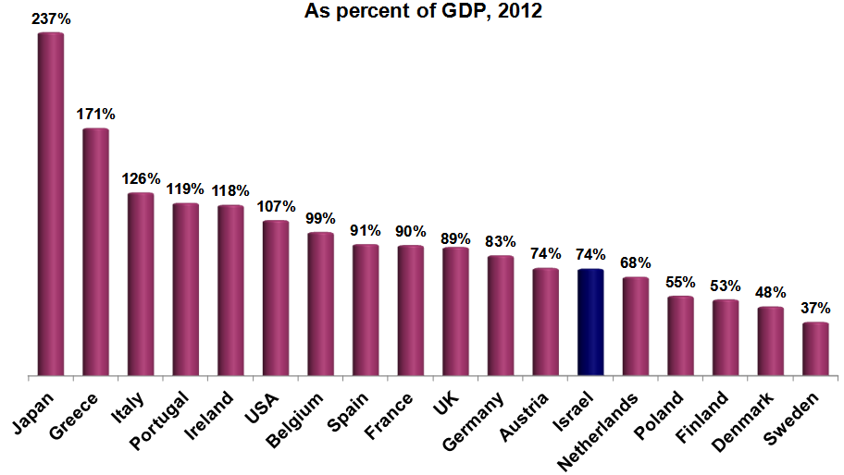
Relatively Low Public Debt Ratio
Source: IMF Fiscal Monitor, October 2012.
Notes:
Y:\מסמכים בטיפול סטטיסטיקה\קבצי אקסל\נתונים בינלאומיים\גרעונות וחובות\חוב ממשלתי לתמג.xlsx

Slide 10
Government Budget Deficit
External shock
5%
External shock

Slide 11
Shadow Economy Est. % of unreported transactions from 2007 GDP
Source: New Estimates for the Shadow Economies all over the World" by Friedrich Schneider, Andreas Buehn, and Claudio E. Montenegro, 2010

Slide 12
Relatively Low Unemployment
Source: OECD
Notes:
Y:\מסמכים בטיפול סטטיסטיקה\קבצי אקסל\משק\חשבונות לאומיים\תחזית 2013\תחזית 2013 - 30 באוקטובר 2012 + עדכון נתוני תעסוקה.xlsx

Slide 13
UNEMPLOYMENT RATES
*OECD StatExtracts

Slide 14
High Share of ICT in the Business Sector
ICT= Information & Communications Technologies, 2008
Source: Israel CBS
Notes:
קבצי אקסל>נתונים בינלאומיים>השוואות בינלאומיות שונות –ICT השוואה בינלאומית מהתוצר העסקי

Slide 15
Relatively Young Population
Source: CIA Factbook
Notes:
Y:\מסמכים בטיפול סטטיסטיקה\קבצי אקסל\נתונים בינלאומיים\גרעונות וחובות\חוב ממשלתי לתמג.xlsx

Slide 16
Median Age (Years) of Population
Eurostat and CIA Factbook statistics

Slide 17
Demographics

Slide 18
Energy & Water Consumption
Area | Electricity consumption (kWh/ capita) | Carbon dioxide emissions (CO²/ capita) | Freshwater use (abstraction m³/ capita) | Freshwater intensity of use (abstraction as % of internal resources)
OECD | 8226 | 9.95 | 840 | 10.3
ISRAEL | 6927 | 8.66 | 220 | 86.4
Source: http://www.iea.org (2013; data from 2009-2012)

Slide 19
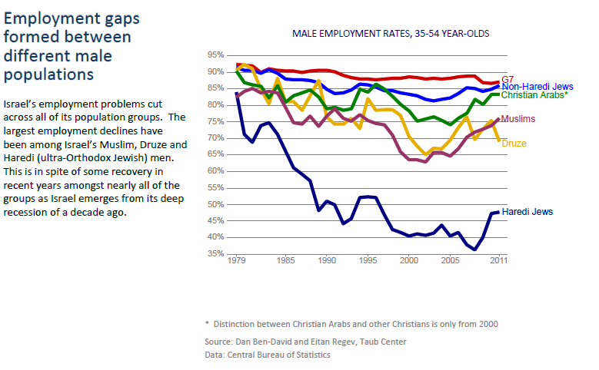
Employment Gaps Between Different Male Populations

Slide 20
Foreign Direct Investments in Israel (Billions $)
Notes:
Y:\מסמכים בטיפול סטטיסטיקה\קבצי אקסל\השקעות\השקעות זרות ריאליות - FDI.xls

Slide 21
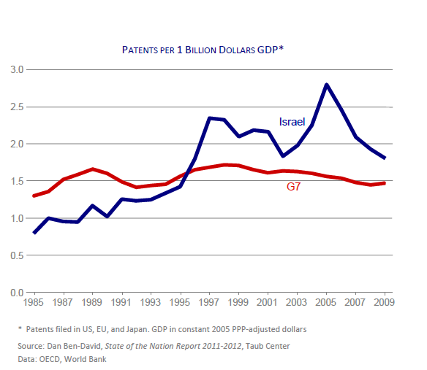

Israeli Innovation above G7 countries since mid- 1990s

Slide 22
World Leadership in Civilian R&D Investments
Source: Israel CBS

Slide 23






















Global R&D and Innovation Center

Slide 24




Israeli Innovation
Disk-on-Key (Flash Memory) by SanDisk
PillCam (aka capsule endoscopy) by Given Imaging
Copaxone (immunomodulator drug for treating multiple sclerosis) by Teva
ICQ (instant messaging program) by Mirabilis

Slide 25


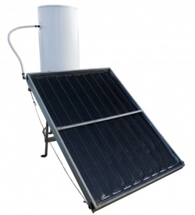

Israeli Innovation
Firewall (traffic filtering software) by Check Point
Irrigation Systems by Netafim
Solar energy
Waze navigation + real-time traffic analysis and reporting application

Slide 26



Israeli Innovation
Epilady (Epilator) by Mepro, Kibbutz HaGoshrim, 1986
Skype Technology (Voice over Internet Protocol) by VocalTec
Cherry Tomatoes (Tomaccio tomatoes) by Prof. Keidar & Prof. Rabinovitch, Hebrew University, 1973

Slide 27
The main reason of 2011 protests: High Cost of Living

Slide 28

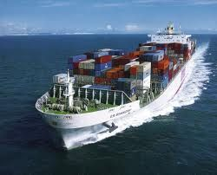




Major Challenges
Global Economy
Exports Profitability
Local Economy
Inputs Costs
State Budget
Bureaucracy, Regulation & Industrial Relations

Slide 29
Evolution of Israel’s Export, 1980-2012
(in B$, Including diamonds and services)

Slide 30
Local Currency Exchange Rate Compared to Main Competitors
-22%
$=3.6 NIS
30

Slide 31
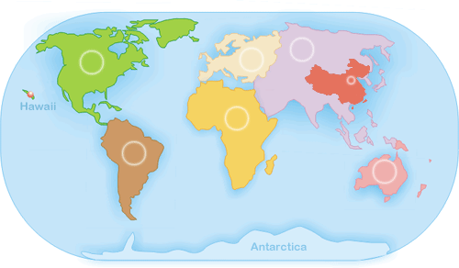

7 Free Trade Agreements with 39 countries
Allowing products to enter without duty
E.F.T.A
Switzerland Norway, Iceland, Liechtenstein
Canada
E.U.
(28 Countries)
Turkey
U.S.A
Ukraine
China
S. Korea
India
Mexico
ISRAEL
Panama
Colombia
MERCOSUR
Brazil, Argentina,
Uruguay , Paraguay
Negotiated / Considered
Notes:
באיחוד 27 מדינות, כולל רומניה ובולגריה

Slide 32
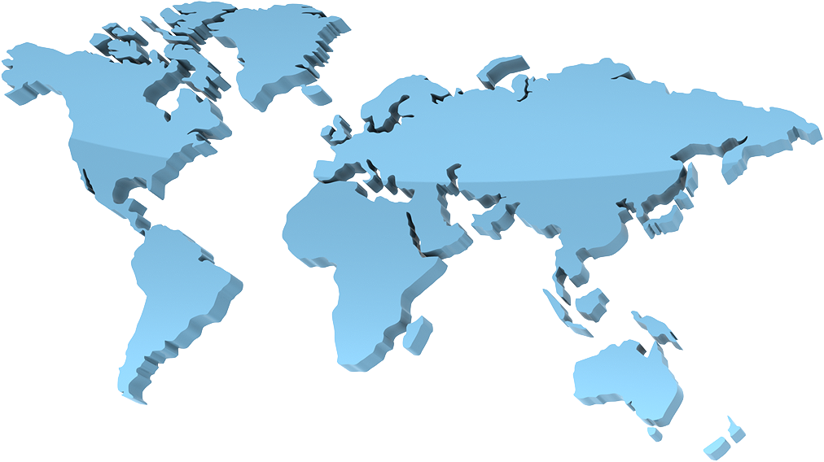
Israeli Industrial Goods Export by Continent 2012 (excl. diamonds)
European Union 31%
$ 14.3 B
Rest of Europe 7%
$ 3.3 B
North America 26%
$ 12 B
Asia 21%
$ 9.5 B
Latin America 5%
$ 2.2 B
Africa 3%
$ 1.4 B
Rest of the World 7%
$ 3 B
Total : $ 45.7 Billion
Total : $ 64895.1 Billion

Slide 33
Industrial Goods Import by Continent 2012 (excl. diamonds)
European Union 34%
$ 22.5 B
Rest of Europe 8%
$ 5.5 B
North America 15%
$ 9.2 B
Asia 20%
$ 13.2 B
Latin America 2%
$ 0.8 B
Africa 1%
$ 0.4 B
Rest of the World 20%
$ 13.5 B
Total : $ 64.9 Billion
Total : $ 64895.1 Billion

Slide 34
2012 Industrial Goods Import by Sectors
(excl. diamonds)
Total : $ 64.9 Billions
Total : $ 64.9 Billions

Slide 35
2012 Industrial Goods Export by Sectors
(excl. diamonds)
Total : $ 45.67 Billions
Total : $ 45.67 Billions

Slide 36
Israeli Bilateral Trade with EU
2008-2012
Notes:
באיחוד 27 מדינות, כולל רומניה ובולגריה

Slide 37
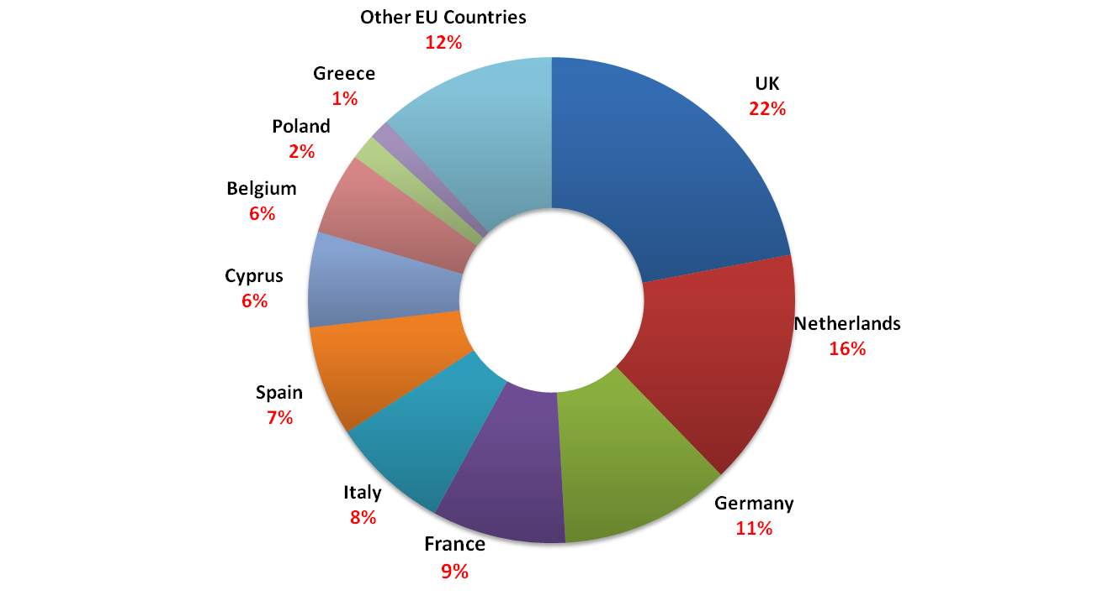
Top Export Destinations in EU 2012
(excl. diamonds)
Total : 14.3 $ Billion

Slide 38
Israeli – Polish Bilateral Trade 2009 – 2012 (million $ excl. diamonds)

Slide 39
Israeli Industrial Export to Poland 2012 (excl. diamonds)
Total Export: 248.9 M$

Slide 40
Polish Industrial Export to Israel 2012 (excl. diamonds)

Slide 41
Thank you! Dziękuję bardzo! Dan Catarivas Foreign Trade & Int’l Relations Division Director Manufacturers Association of Israel (MAI) danc@industry.org.il

